Slide 1
Reddit Posts Classification Model
Presented by – Preety Bhogal

Slide 2

introduction
Major cyber attack – Reddit Website unavailable.
As a Reddit data scientist, tasked to build a classification model.
Trial run for about 2,000 random posts from two subreddits – Excel and Legal Advice.

Slide 3


Problem statement
To build a classification model for accurately classifying the user-posts into distinct subreddits or discussion topics depending on the content of the posts.

Slide 4
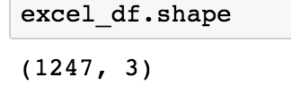
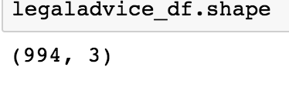
Data
1,000 titles and posts pulled from each subreddit
Data cleaned for punctuations, English stop-words
Data lemmatized and count vectorized for modelling purpose

Slide 5
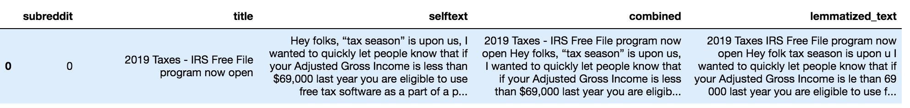
Before Regex
After Regex

Slide 6
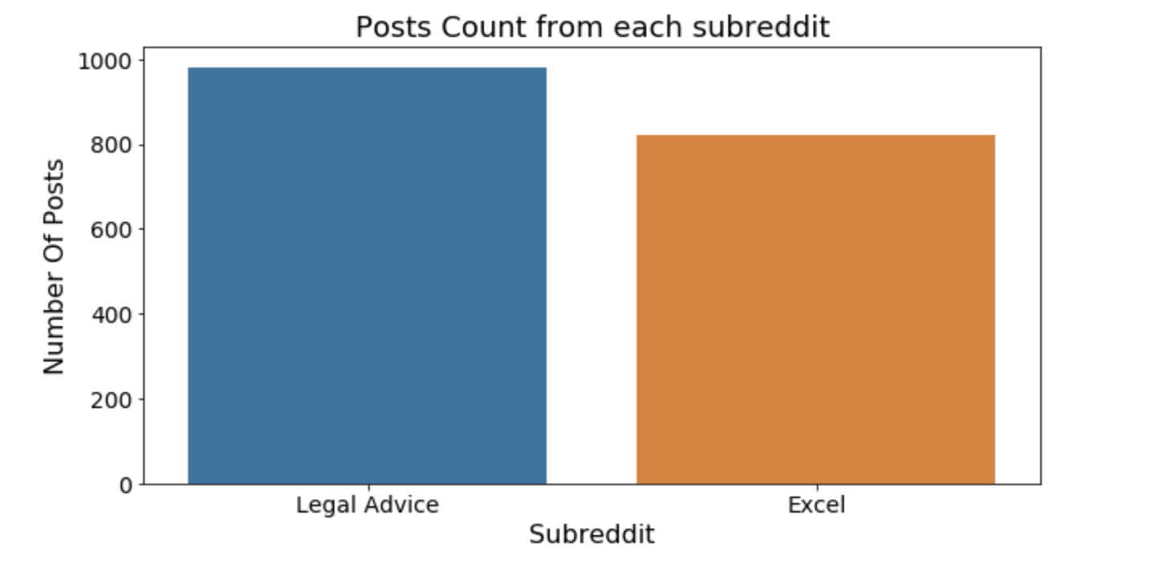
Exploratory data analysis
Final Dataframe

Slide 7
Baseline Accuracy
Legal Advice 54 %
Excel
46%

Slide 8
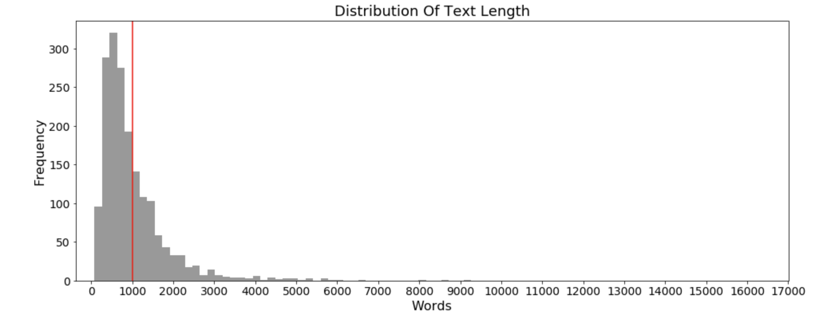
Average number of words in the posts are 1000. Lengthy posts (> 5,000 words) are very few.

Slide 9


Frequently occurring words
Legal Advice
Excel

Slide 10
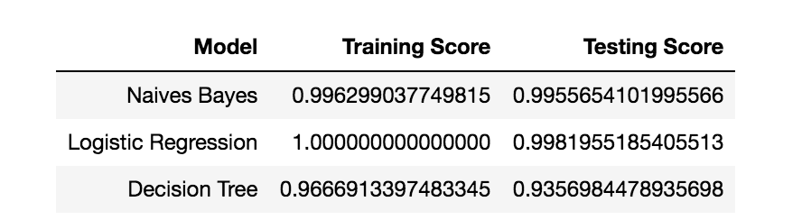
Modelling and evaluation

Slide 11
Conclusion and recommendations
All the three models – overfit – high variance.
Naives Bayes Model performs the best on the dataset – testing score and training score comparison. Highest Accuracy Score - 99.5%
Only 1 post from the Excel subreddit was misclassified as a Legal Advice post and vice-versa
Recommended that the Reddit team employs Naives Bayes Model
Tune some of the hyperparameters for better results.

